Slide 1

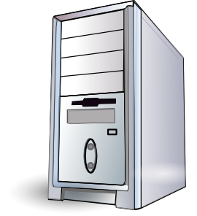




Bank
Shopping Mall
Restaurant
Hospital

